Slide 1
ORGANISATIONAL
BEHAVIOUR
CHAPTER-22
INTERNATIONAL ORGANISATIONAL BEHAVIOUR

Slide 2
LEARNING OBJECTIVES
There is growing internationalization of business.
Culture influences employee behaviour and impact of norms, values, and beliefs varies across countries.
Though there are cultural differences, cultural clusters minimize the need for customizing OB practices.
Individual behaviour across cultures can be understood in terms of motivation, rewards, and managerial responses.
As with individual behaviour, interpersonal behaviour too varies across cultures. Important areas of interpersonal behaviours include leadership, teams, negotiations, and communication.
Convergence brought in by technological advancement makes organization designs across cultures similar.

Slide 3
Cultural Contrasts in Value
Americans Japanese Arabs
1. Freedom 1. Belonging 1. Family security
2. Independence 2. Group harmony 2. Family harmony
3. Self-reliance 3. Collectiveness 3. Parental guidance
4. Equality 4. Age/Seniority 4. Age
5. Individualism 5. Group consensus 5. Authority
6. Competition 6. Cooperation 6. Compromise
7. Efficiency 7. Quality 7. Devotion
8. Time 8. Patience 8. Very patient
9. Directness 9. Indirectness 9. Indirectness
10. Openness 10. Go between 10. Hospitality
11. Aggressiveness 11. Interpersonal 11. Friendship
12. Informality 12. Hierarchy 12. Formal/Admiration
13. Future-orientation 13. Continuation 13. Past and present
14. Risk-taking 14. Conservative 14. Religious belief
15. Creativity 15. Information 15. Tradition
16. Self-accomplishment 16. Group achievement 16. Social recognition
17. Winning 17. Success 17. Reputation
18. Money 18. Relationship 18. Friendship
19. Material possessions 19. Harmony with nature 19. Belonging
20. Privacy 20. Networking 20. Family network

Slide 4
Cultural Clusters
Anglo Nordic Germanic Latin American Latin European
Australia Denmark Austria Argentina Belgium
Canada Finland Germany Chile France
Ireland Norway Switzerland Colombia Italy
New Zealand Sweden Mexico Portugal
South Africa Peru Spain
UK Venezuela
USA
Near Eastern Arab Far Eastern Independent
Greece Abu Dhabi Hong Kong Brazil
Iran Bahrain Indonesia India
Turkey Kuwait Malaysia Israel
Portugal Oman Philippines Japan
Spain Saudi Arabia Singapore
UAE Taiwan
Thailand
Vietnam

Slide 5
Cultural Contrasts in Motivation
American Japanese Arab
Management Styles Leadership; Friendliness Persuasion; Functional Coaching; Personal
group activities attention; Parenthood
Control Independence; Group harmony Of others/parenthood
Decision-making;
Space, Time, Money
Emotional Appeal Opportunity Group participation; Religion; Nationalistic;
Company success Admiration
Recognition Individual contribution Group identity; Individual status;
Belonging to group Class/society; Promotion
Material Awards Salary; Commission; Annual bonus; Gift for self/family; Family
Profitsharing Social services; affair; Salary increase
Fringe benefits
Threats Loss of job Out of group Demotion
Cultural Values Competition; Risk-taking; Group harmony; Reputation; Family security;
Material possession; Achievement; Religion; Social status
Freedom Belonging

Slide 6
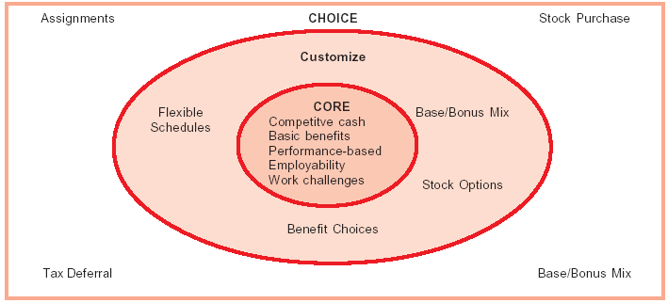
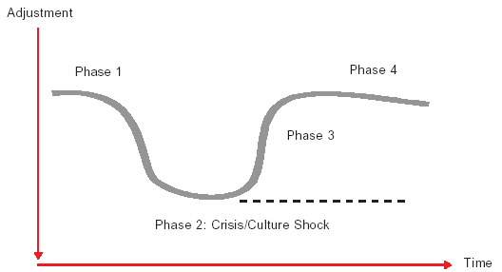
Three Sets of Compensation
The Phases of Cultural Adjustment

Slide 7
Transnationlly Competent Managers
Transnational Skills Transnationally Competent Traditional International
Managers Managers
Global perspective Understand worldwide business from Focus on a single foreign country and a global perspective. on managing relationship between
headquarters and that country.
Local responsiveness Learn about many cultures. Become an expert on one.
Synergistic learning Work with and learn from people from Work with and coach people in each many cultures simultaneously. Create foreign culture separately or sequentially. a culturally synergistic organizational Integrate foreigners into the environment. headquarter’s national organizational culture.
Transition and adaptation Adapt to living in many foreign cultures. Adapt to living in a foreign culture.
Cross-cultural interaction Use cross-cultural interaction skills on a Use cross-cultural interaction skills daily basis throughout one’s career. Primarily on foreign assignment.
Collaboration Interact with foreign colleagues Interact within clearly defined hierarchies as equals. of structural and cultural dominance.
Foreign experience Transpatriation for career and Expartriation or inpatriation primarily to organization development. get the job done.

Slide 8
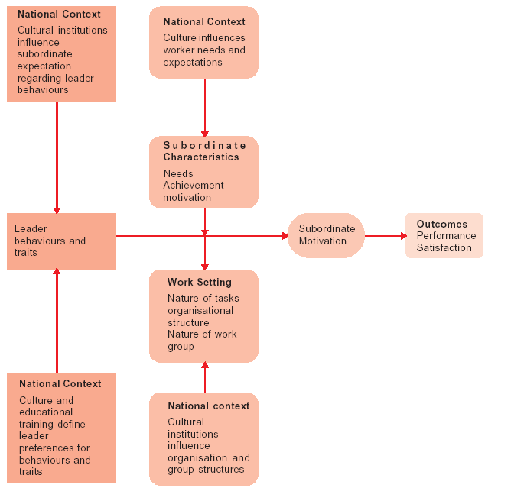
National Context Contingency Model of Leadership

Slide 9
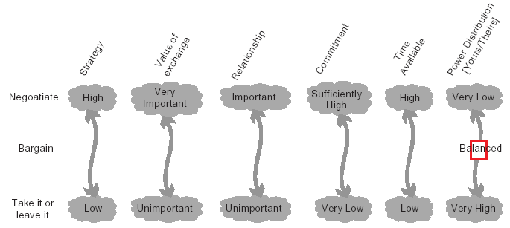
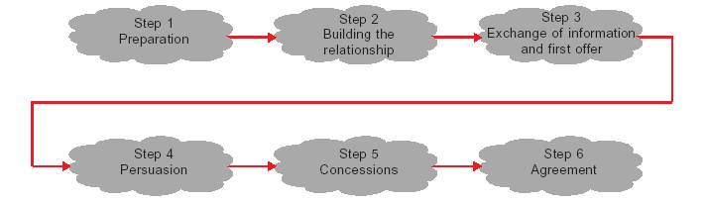
When to Negotiate?
Steps in International Negotiations

Slide 10
Negotiating Tactics
Tactic Description Example
Promise I will do something you want me to do, if I will lower the price by $5 if you increase
you do something I want you to do the order by 100 units.
(conditional, positive).
Threat I will do something you don’t want me to I’ll walk out of the negotiation if you leak this
do, if you do something I don’t want you story to the press.
to do (conditional, negative).
Recommendation If you do something I want you to do, If you lower your price, more teenagers will
a third party will do something you want be able to buy your product.
(third party positive).
Warning If you do something I don’t want you to do, If you don’t settle, the press will spill this
a third party will do something you don’t whole sordid story on the front page of every
want (third party negative). newspaper in the country.
Reward I will give you something positive Let’s make it easier on you tomorrow and meet
(something) you want now, on the spot closer to your office. I have really appreciated
(unconditional, positive). your willingness to meet at my building.
Punishment I will give you something negative I refuse to listen to your screaming. I am
(something you don’t want) now, on leaving.
the spot (unconditional, negative).
Normative Appeal I appeal to a societal norm. Everybody else buys our product for
$5 per unit.
Commitment I will do something you want (unconditional, I will deliver 100 units by June 15.
positive).
Self-disclosure I will tell you something about myself. We have had to lay off 100 employees this
month. We really need to sign a major contract
by the end of the year.
Question I want to ask you something about yourself. Can you tell me more about your Brazilian
operation?
Command I order you to do something. Lower your price.

Slide 11
Summary
        OB experts need to take care of the increasing globalization of business.
        Cross-cultural impact is noticed on employee behaviour.
        Culture clusters are of great help to international managers. Hofstede’s cultural dimensions are highly relevant for international organizational behaviour.
        Motivational principles and practices vary across cultures.
        Compensation too varies across countries.
        Interpersonal behvaiour also varies across cultures.
        Negotiating across cultures is the single most important business skill.
        Successful negotiation requires equally successful communication.
        Organizational designs are influenced by multicultures.

Slide 12
Key Terms
Trends in international business
Cultural norms
Cultural clusters
Motivation across culture
Cultural adjustment
Multicultural teams
Communication across cultures
Culture-free theory
International OB
Cultural values
Hofstede’s cultural dimensions
Compensation across cultures
Leadership across cultures
Global negotiation
Convergence theory

